Slide 1
265ced1609a17cf1a5979880a2ad364653895ae8
Engaging the users and
Gamifying the
experience
Mentor: Madhuri Pendyala
& Manoj Kumar C A
Intern: Kunal Narang
Notes:
Cover example with no photo
To update the text, just click on the text
To get more slides with this layout just copy this slide and paste

Slide 2

Focus on the key sections where user may feel disconnected or disengaged during his journey on the website and create solutions to solve the same
Notes:
When was the last time u guys played an online video game
The excitement of getting new rewards gets u stuck to the screen for hours.
Gamification uses various feel good factors to
U guys must have played video games .
Its too late before u relaise ur 10 min break lasted for an hour.
What keeps us stuck]
Thrill of rewards
Can we leverage the same concept that games use to our benefit.
What is gamification, what is eccom website without gamification. What gamification does????
Problem statement

Slide 3
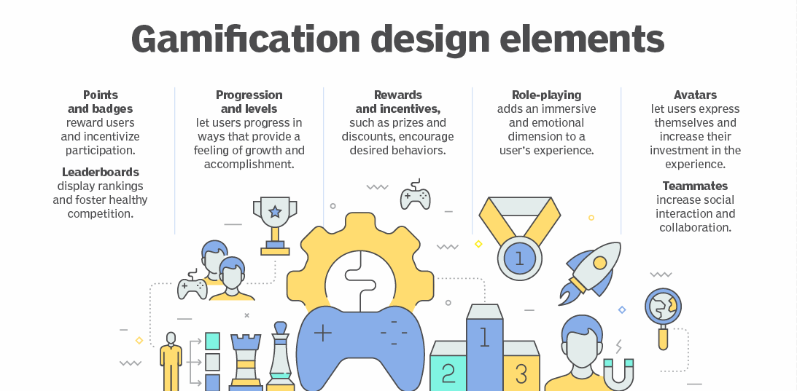
Notes:
So how do u gamify ur website?? Well do u literally add a game. No we carefully select the elements that everyone loves about games and add them in a very subtle way. Our aim is to make the flow same for our conventional user but also ….
Gamification design elements include
Various companies have emerged out of good user experience
Design approach
All eccom websites are going towards gamification.
Pick 1 topic and explain that very well.
Explain duolingo example

Slide 4
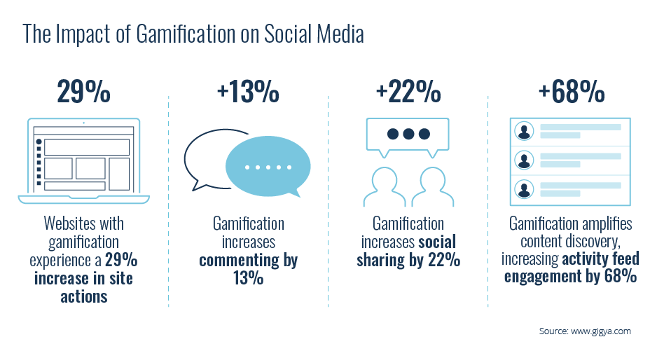

Slide 5

Roadmap
Loyalty Dashboard Travel Map
Profile Avatars
Travel Postcards
Travel destination
suggestions
Notes:
Coming to roadmap. After quite some discussions we had decided the use cases.I had presented one of my usecase my loyalty dashboard travel map in the mid review presentation and a few more use cases have been implemented. Ill quickly run u thru travel maps again before moving to the new stuff

Slide 6
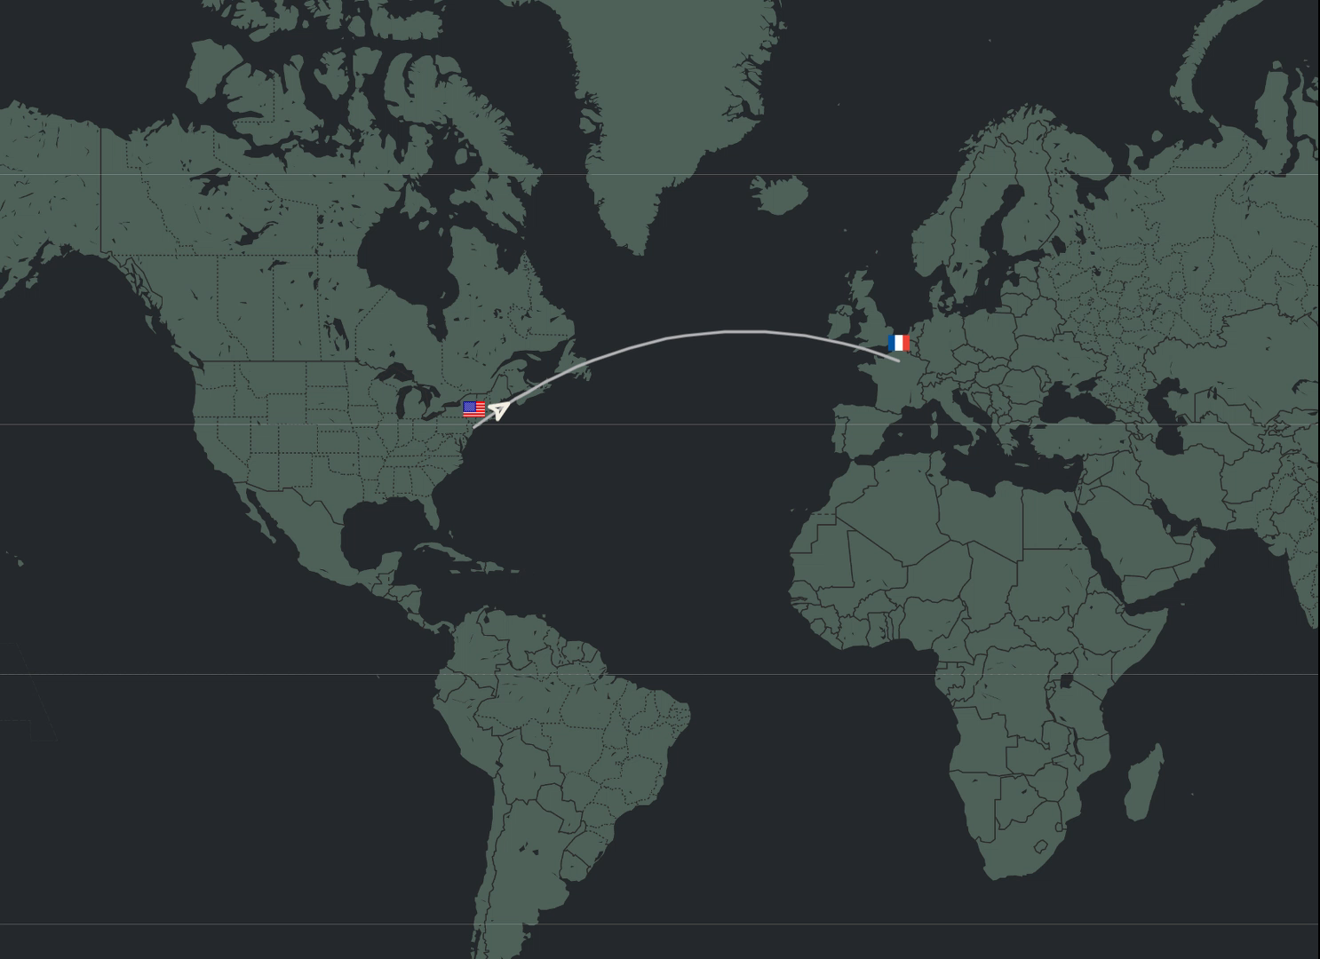
Loyalty Dashboard Travel Map
Notes:
It’s an interactive widget where the user can see his/her past bookings in a visual format that is much more appealing. The user can apply some basic timeline filters.He can run thru his past bookings and can see all his flights together.

Slide 7
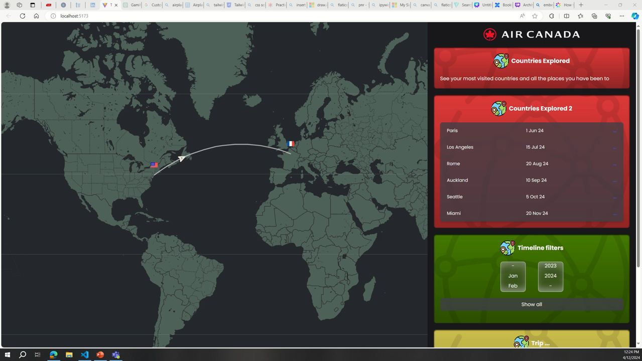

Slide 8
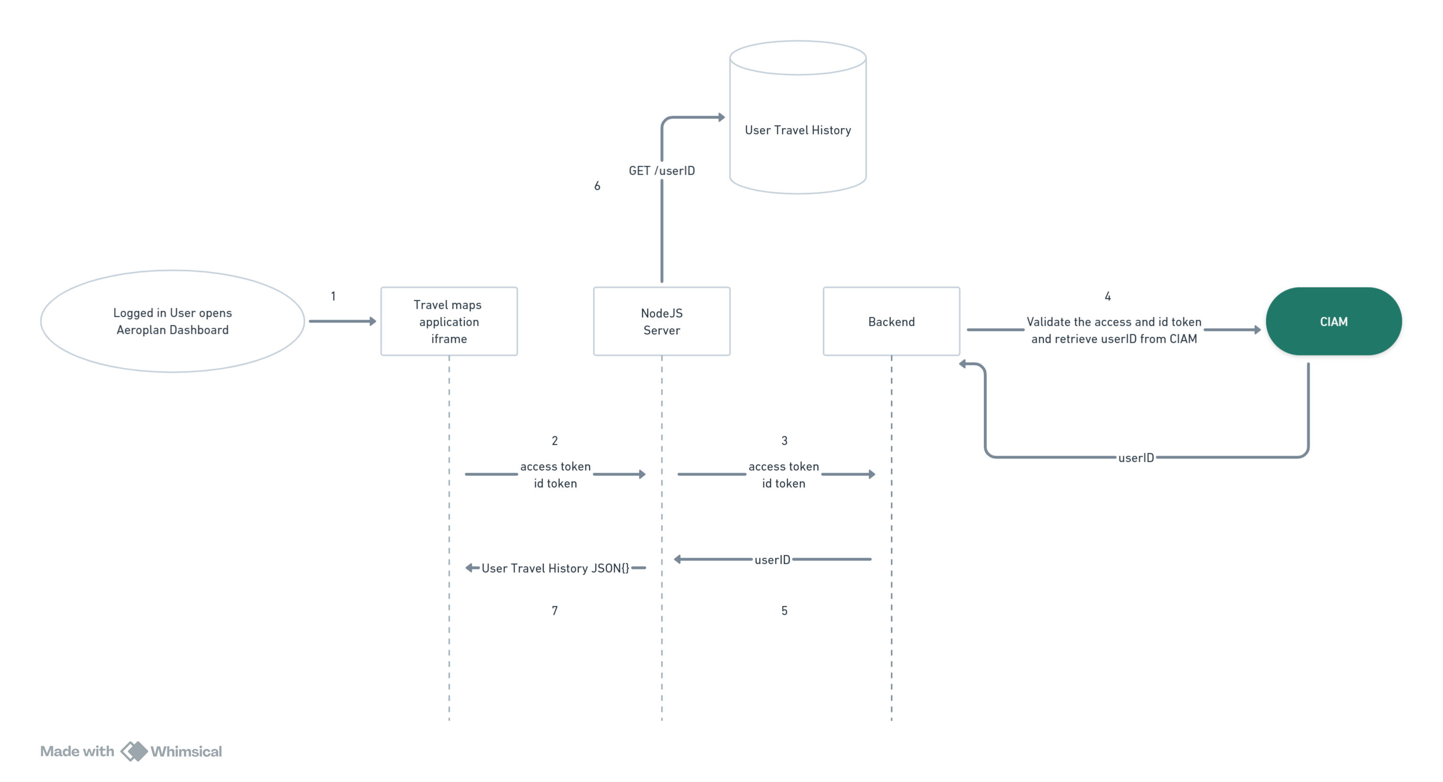
Data Retrieval Flow
Notes:
This is a basic workflow of how user data is retreived.

Slide 9
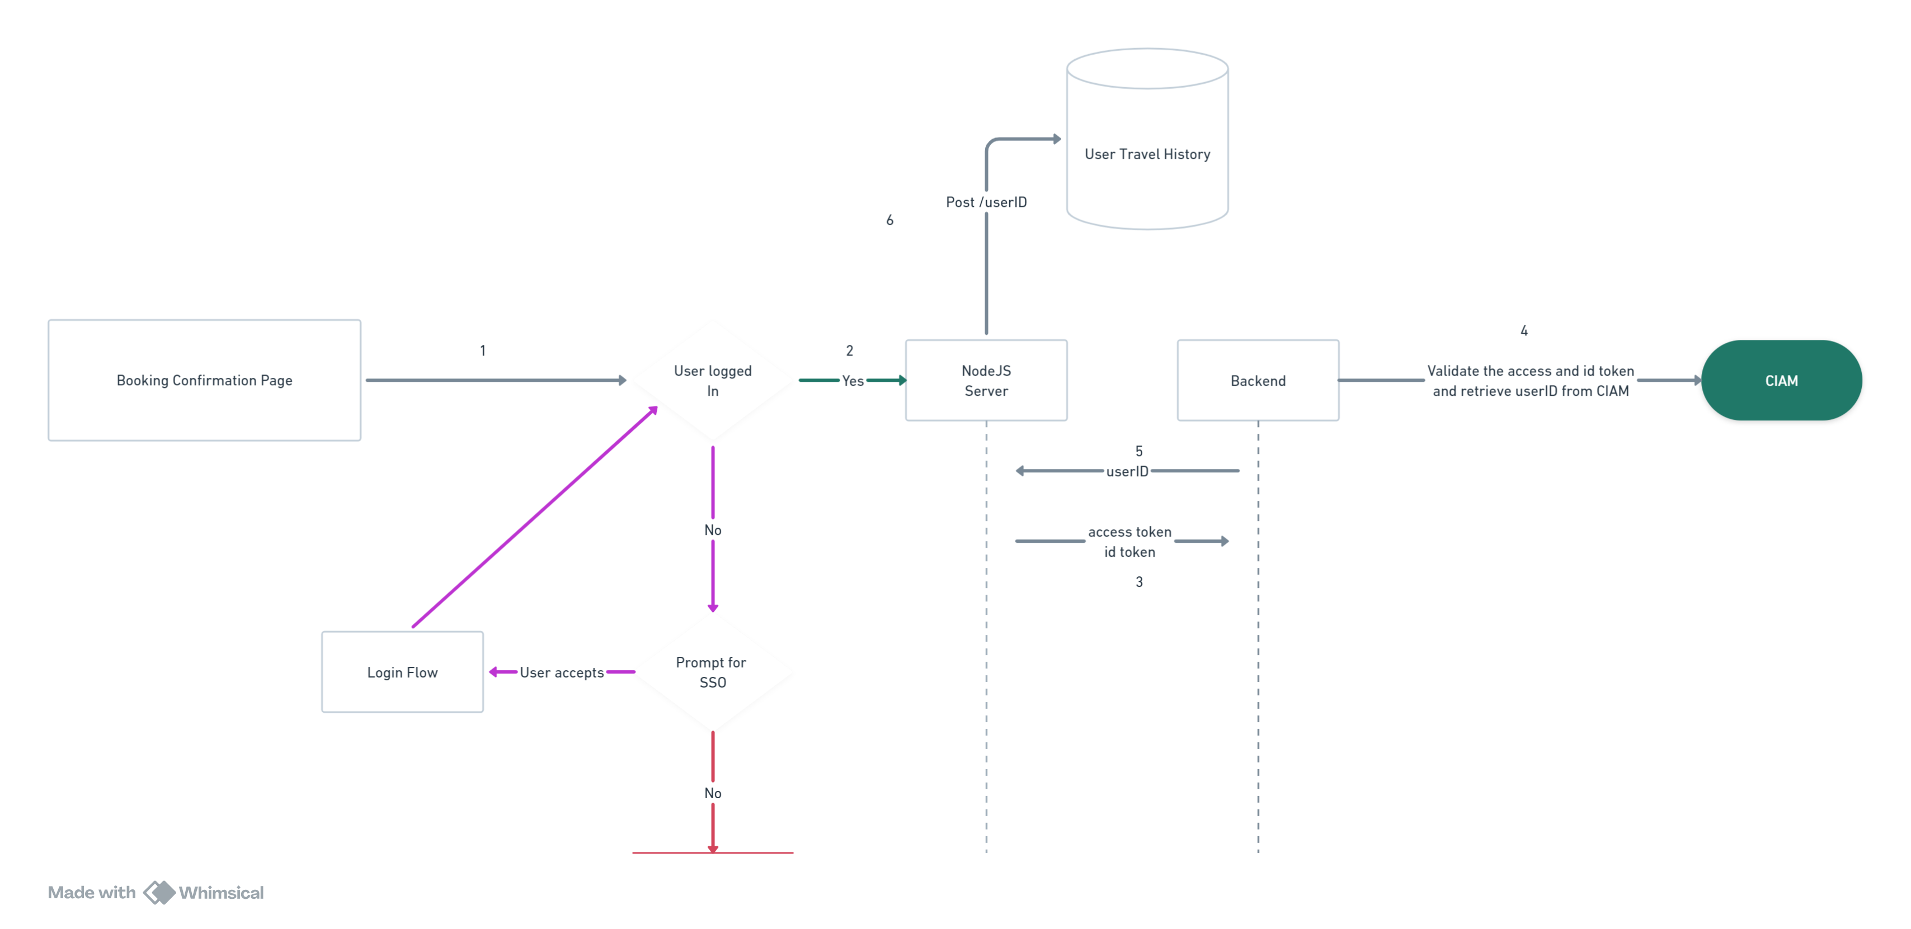
Data Ingestion Flow

Slide 10

User
Avatars
Notes:
Personalisation. It lets the user add a sprinkle of character to their information/profile, it lets them have their own little imprint on it which in turn makes the user feel good
It may show users (or make them feel) that the company doesn't just think they are a number or name, they are more than that. Its a face to a name.

Slide 11
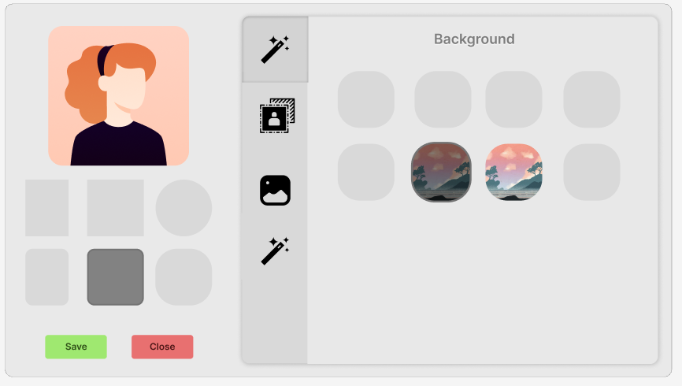

Slide 12
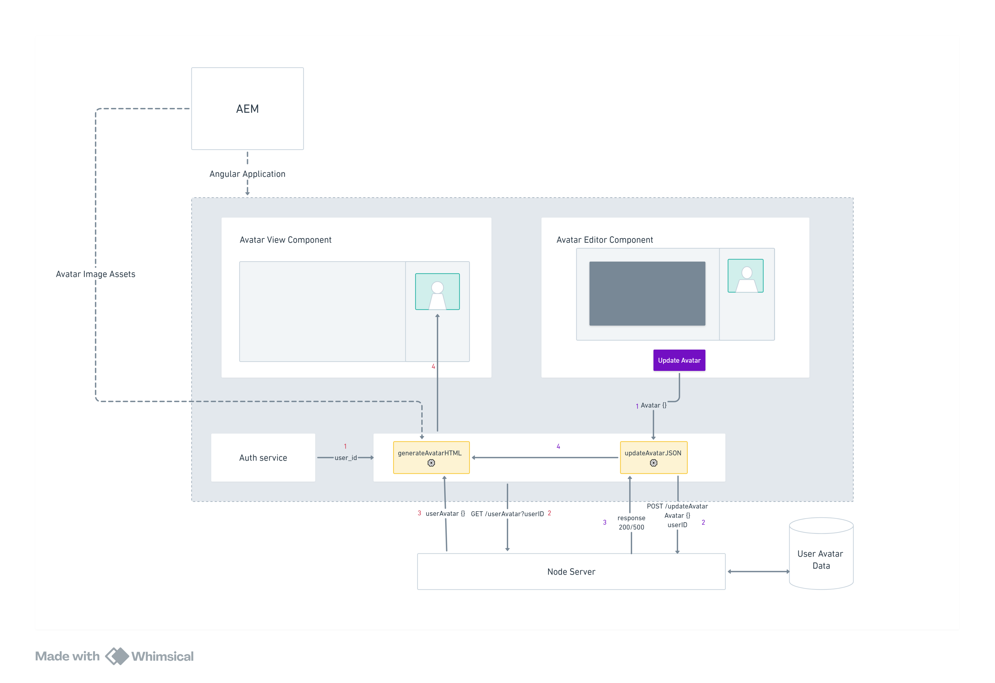
Notes:
2 components
Avatar viewer and the editor component
2 services
Dbaas Service
Avatar service
We also have added a node server to interface with mongodb
The air Canada website is currently hosted using Aem(Adobe experience manager)
It is serving our angular application along some assets.
When the user enters the website and logs in the dbaas service passes on the userid and initializes the generate function of the avatar service . It fetches the user avatar configuration file from the mongodb database and loads the required assets from aem to dynamically generate the avatar at runtime rather than a stored image.
The avatar editor follows a similar schema and updates the configuration to our database

Slide 13

Travel Cards
Notes:
Travel cards provide the user an interactive user for itenary building .User can create their own deck which they can use in future. A very good future buildup would be doing some route planning and improving card suggestions using user feedback.

Slide 14
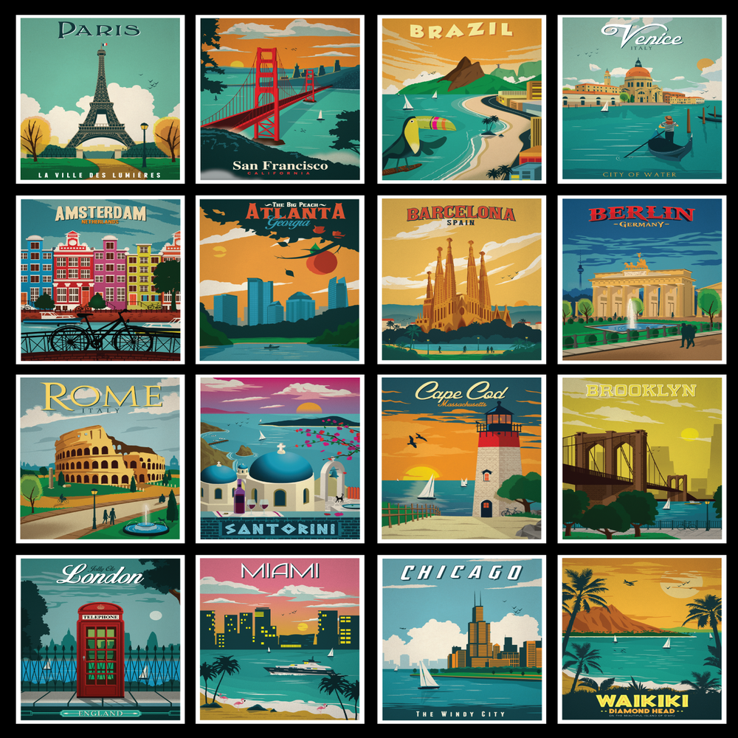

Slide 15
Challenges Faced
Learning Google maps API and tackling the issue of API keys
Integrating the web component in existing application
Tackling the authorization flow for embedded iframe
Learning AEM
Integrating Amadeus Internal APIs
Notes:
Face the issue of not having images
So that would be a great improvement to have

Slide 16










Authorization using JWTs
HTML, CSS, JS
Web Components
Angular
LEARNINGS
Google Maps API
Figma
Express Mongo
Integration
AEM
Notes:
Google API
Web components
Angular
Authorization using JWT(Conceptual)
HTML
CSS
JS
Tailwind CSS
Figma – created your own mockups
Express mongo
Make node servers scalable

Slide 17


Slide 18
?
Any Questions
?
?
?
?

